Slide 1
What’s Ahead? Gearing Up for 2020 & Closing Out 2019
Presented to:
Arizona Environmental Strategic Alliance
Environmental Compliance Assistance for Business & Industry Seminar
(October 29, 2019)
Amanda A. Reeve
Environmental & Regulatory Policy Advisor
Snell & Wilmer LLP

Slide 2
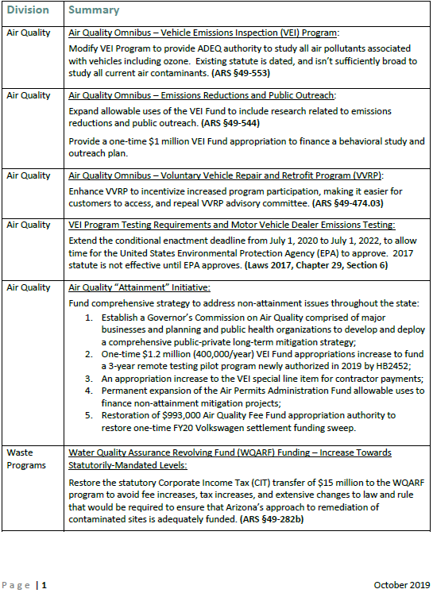
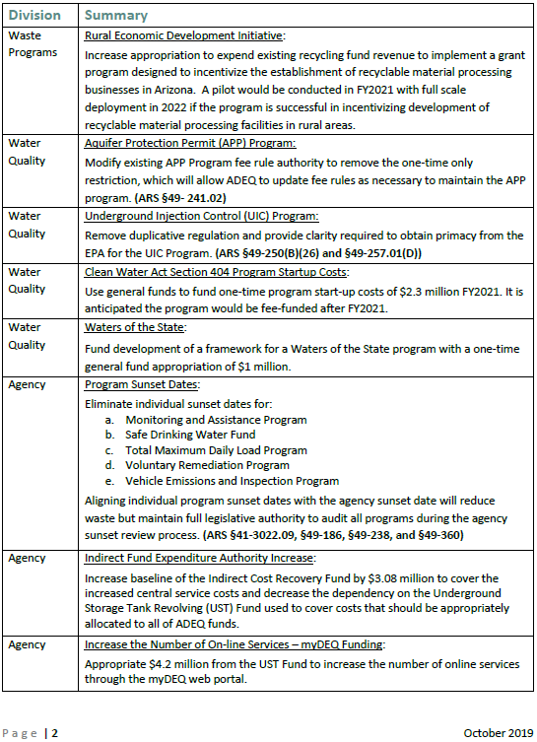
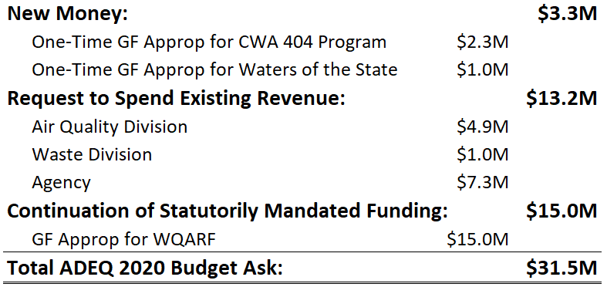

Slide 3
Air Quality $4.9M
ADEQ 2020 Budget and Legislative Ideas

Slide 4
Air Quality Policy Initiatives

Slide 6
Waste $16M
ADEQ 2020 Budget and Legislative Ideas

Slide 8
WaTER $3.3M
ADEQ 2020 Budget and Legislative Ideas

Slide 9
Water Quality Policy Initiatives

Slide 11
Agency $7.3M
ADEQ 2020 Budget and Legislative Ideas

Slide 12
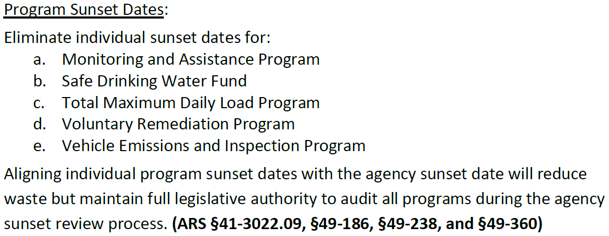
Agency Policy Initiatives

Slide 14
Agency
Closing Out 2019: ADEQ Public Input Opportunities

Slide 15
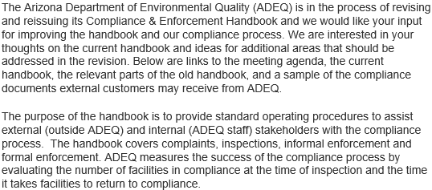

Slide 16
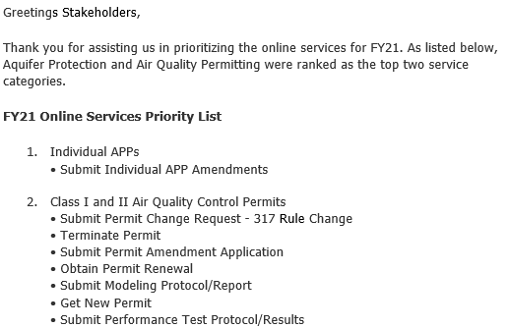

Slide 17
Air Quality Division
Closing Out 2019: ADEQ Public Input Opportunities

Slide 18
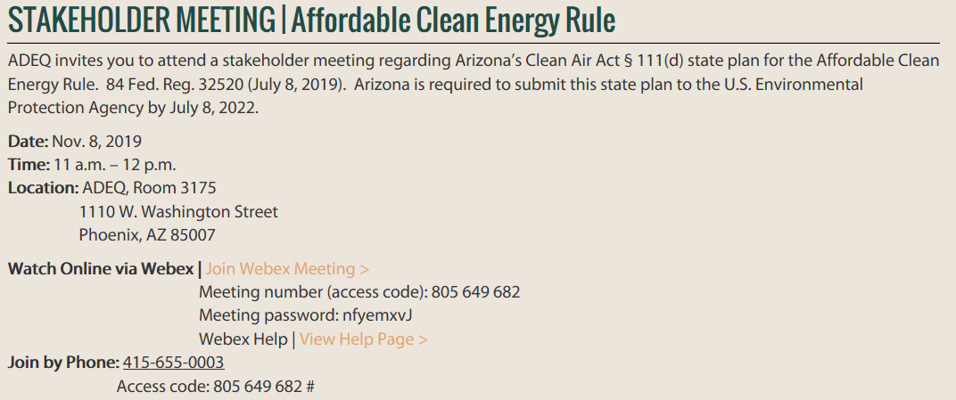

Slide 19
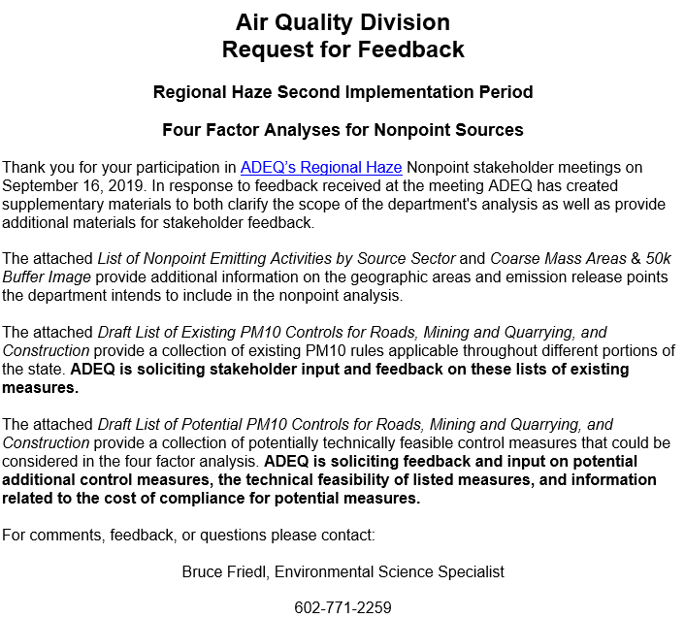
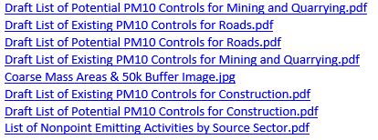
Comments/Feedback Due:
December 2, 2019
Submit to:
Bruce Friedl
602-771-2259
FRIEDL.BRUCE@AZDEQ.GOV

Slide 20
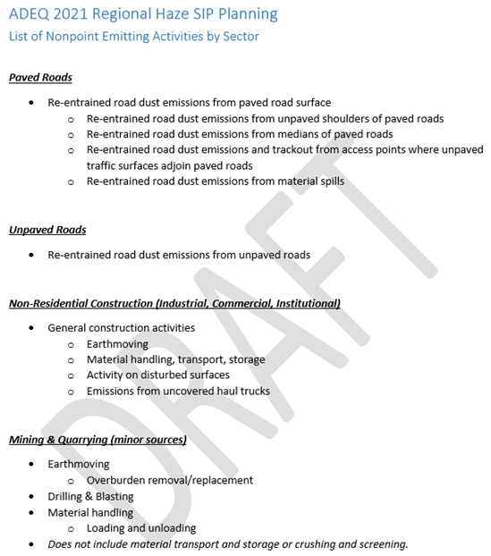
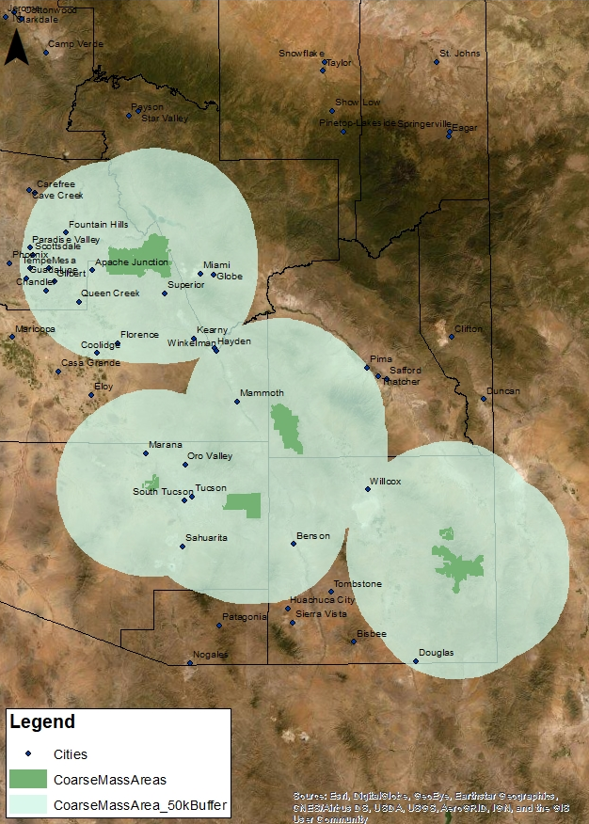
The attached List of Nonpoint Emitting Activities by Source Sector and Coarse Mass Areas & 50k Buffer Image provide additional information on the geographic areas and emission release points the department intends to include in the nonpoint analysis.

Slide 21
Water Quality Division
Closing Out 2019: ADEQ Public Input Opportunities

Slide 22
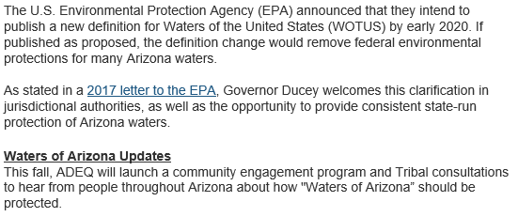
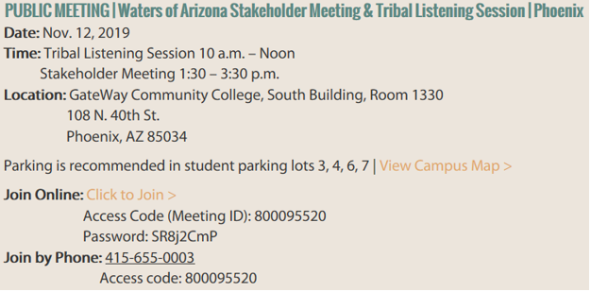
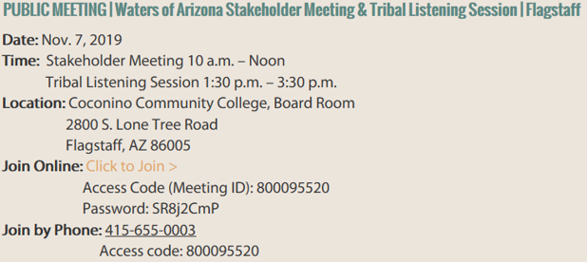
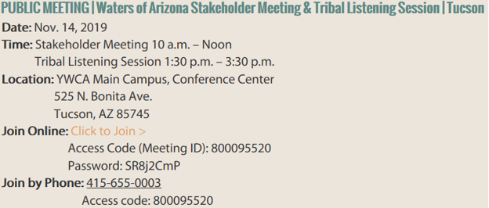
Phoenix
Nov. 12th
Flagstaff
Nov. 7th
Tucson
Nov. 14th

Slide 23
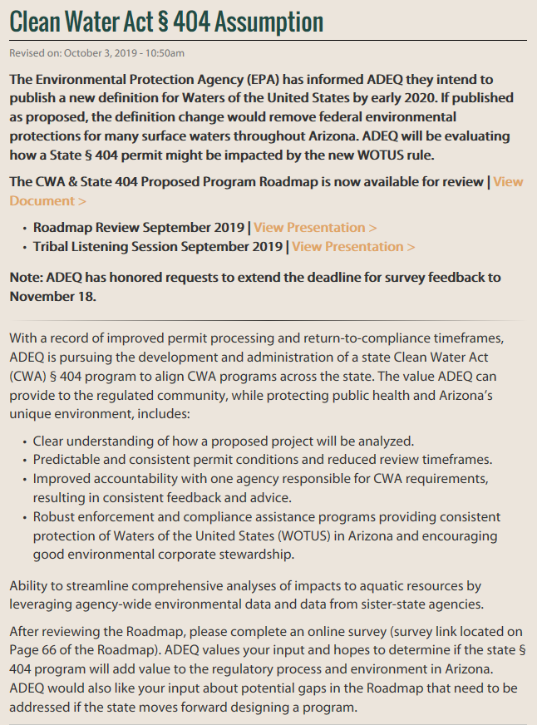

Slide 24
